Slide 1
Data Flow Diagrams for Cycle 2
8.03 Creating Purchase Order
8.04 Approving Purchase Order
8.06 Managing Documents
9.02 Submitting and Approving Expenses
9.05 Approve Expenses
9.07 Integrate Payroll
10.02 Processing the Payment
10.05 Managing Customer Credit Note
11.03 Implement Automation & Integrations

Slide 2
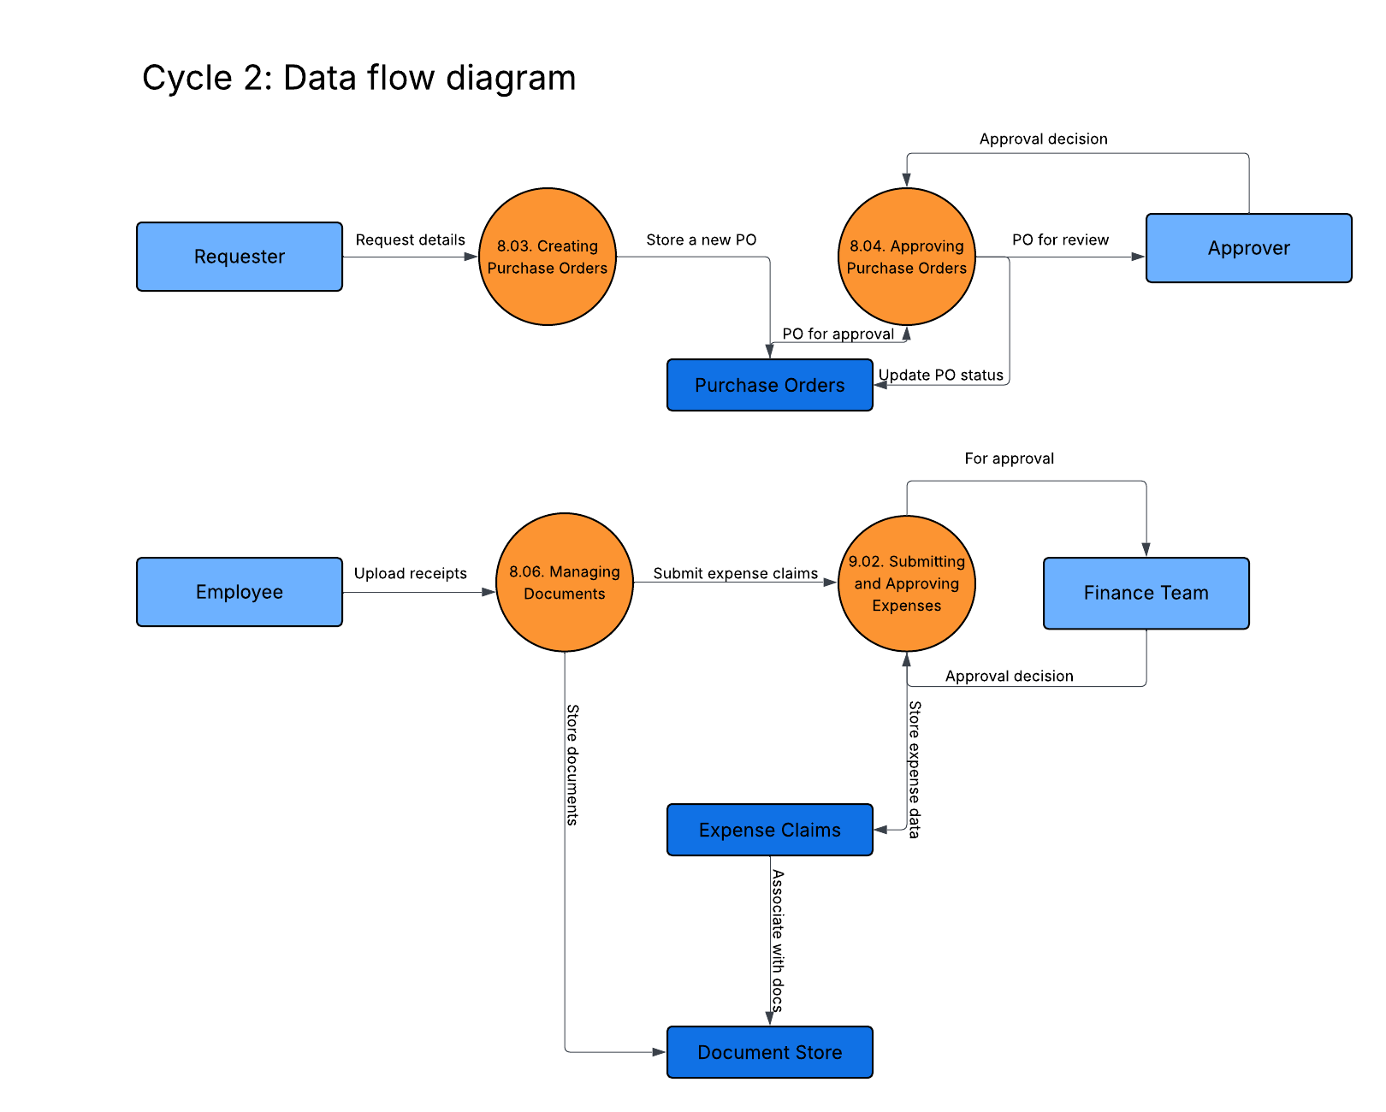

Slide 3
